Slide 1
UNIT – 4 Software Metrics

Slide 2
Software Metrics
“The continuous application of measurement based techniques to the software development process and its products to supply meaningful and timely management information, together with the use of those techniques to improve that process and its products”.

Slide 3
Software metrics is all about measurements which in turn, involve numbers, the use of numbers to make things better, to improve the process of developing software and to improve all aspects of management of that process.
It covers the techniques for monitoring and controlling the process of software development, such that the fact it is going to be late for six months can be recognized as early as possible rather than the day before delivery is due.

Slide 4
Area of Applications
Most established area of software metrics is Cost and Size estimation techniques.
Controlling software development projects through measurement is an area of great deal of interest.
The prediction of quality level for software, often in terms of reliability, is another area where Software metrics have an important role to play.
Software metrics is also used to provide management information. This includes information about productivity, quality and process effectiveness.

Slide 5
Problem during Implementation
Implementing Software metrics in an organization of any size is difficult.
Another problem during implementation arises if we start measuring the performance of the individuals. “this may appear attractive to some managers”.
Software metrics cant solve all the problems, and they can enable managers to improve their processes, to improve productivity and quality.

Slide 6
Categories of Metrics
Product Metrics:- Describes the characteristics of the product such as size, complexity, design features, performance, efficiency, reliability, portability etc.
Process Metrics :- describe the effectiveness and quality of the processes that produce the software product. Example :-
- effort required in the process
- time to produce the product
- effectiveness of defect removal during development.
- number of defects found during testing
Project Metrics:- describe the project chracteristics and execution. Example
- number of software developers
- staffing pattern over the life cycle
- cost and schedule
- productivity.

Slide 7
Information Flow (IF) Metrics
IF metrics model the degree of cohesion and coupling for the particular system component.
Cohesion :- if the component has to do numerous tasks, it is said to have lack of “cohesion”.
Coupling :- if it passes to and/or accepts information from many other components with in the system, it is said to highly coupled.

Slide 8
Component :- Any element identified by decomposing a software system into its constituent parts.
Cohesion :- the degree to which a component performs a single function.
Coupling :- degree of linkage between one component to others in the same system.

Slide 9
Basic IF Model
FAN IN , is simply a count of the numbers of other components that can call, or pass control.
FAN OUT, is the number of components that are called by a component.
IF(component) = [ FAN IN * FAN OUT ]²

Slide 10
High FAN IN indicate lack of cohesion.
High FAN OUT also indicate a lack of cohesion.
High IF indicate highly coupled components.

Slide 11
Token Count
Halstead developed software science family of measures based on tokens known as Halstead Analysis (Halstead Metrics)
Token = Operand or operator
Vocabulary
The size of the vocabulary of a program, which consists of the number of unique tokens used to build a program is defined as:
η = η₁+ η₂
Where
η : vocabulary of a program
η₁ : number of unique operators
η₂ : number of unique operands

Slide 12
Token Count
Program Length
The length of the program in the terms of the total number of tokens used is
N = N₁+N₂
Where
N : program length
N₁ : total occurrences of operators N₂ : total occurrences of operands

Slide 13
Token Count
Volume
V = N * log₂ η
The unit of measurement of volume is the common unit for size “bits”. It is the actual size of a program if a uniform binary encoding for the vocabulary is used.
Program Level
L = V* / V
The value of L ranges between zero and one, with L=1 representing a program written at the highest possible level (i.e., with minimum size).
V*=minimum volume of the algorithm implemented with a program as same algo can be implemented by many programs

Slide 14
Token Count
Program Difficulty
D = 1 / L
As the volume of an implementation of a program increases, the program level decreases and the difficulty increases. Thus, programming practices such as redundant usage of operands, or the failure to use higher-level control constructs will tend to increase the volume as well as the difficulty.
Effort
E = V / L = D * V
The unit of measurement of E is elementary mental discriminations.

Slide 15
Token Count
Estimated Program Length (Halstead Length estimate)
∧
Ν = η₁ log ₂ η₁ + η ₂ log ₂ η ₂
The following alternate expressions have been published to estimate program length.
Ν _{J} = Log₂ (η₁!) + log₂ (η₂!)
Ν _{B} = η₁Log₂η₂ +η₂ log₂ η₁
Ν_{c} = η₁(η₁)^{1/2} +η₂ (η₂)^{1/2}
Ν _{s} = (η log₂ η) / 2

Slide 16
Token Count
Counting rules for C language
Comments are not considered.
The identifier and function declarations are not considered.
All the variables and constants are considered operands.
Global variables used in different modules of the same program are counted as multiple occurrences of the same variable.
Local variables with the same name in different functions are counted as unique operands.
Functions calls are considered as operators.
All looping statements e.g., do {…} while ( ), while ( ) {…}, for ( ) {…}, all control statements e.g., if ( ) {…}, if ( ) {…} else {…}, etc. are considered as operators.
In control construct switch ( ) {case:…}, switch as well as all the case statements are considered as operators.

Slide 17
Token Count
The reserve words like return, default, continue, break, sizeof, etc., are considered as operators.
All the brackets, commas, and terminators are considered as operators.
GOTO is counted as an operator and the label is counted as an operand.
The unary and binary occurrence of “+” and “-” are dealt separately. Similarly “*” (multiplication operator) are dealt with separately.

Slide 18
Token Count
In the array variables such as “array-name [index]” “array- name” and “index” are considered as operands and [ ] is considered as operator.
In the structure variables such as “struct-name. member-name” or “struct-name -> member-name”, struct-name, member-name are taken as operands and ‘.’, ‘->’ are taken as operators. Same names of member elements in different structure variables are counted as unique operands.
All the hash directive are ignored.

Slide 19
Potential Volume
V * = (2 +η * ) log (2 +η* )
2 2 2
Where η₂ * is the number of conceptually unique input and output parameters
Estimated Program Level / Difficulty
∧
Halstead offered an alternate formula that estimate the program level.
∧
L = 2η₂ /(η₁Ν₂ )
where
∧
D =
1 η₁Ν₂
=
2η
∧
L
2

Slide 20
Effort and Time
∧ ∧
Ε = V / L = V * D
= (n₁ N₂ N log₂ η) / 2η₂
Estimated time T = E / β
β is normally set to 18 since this seemed to give best results in
Halstead’s earliest experiments, which compared times with observed programming times, including design, coding, and testing.
the predicted the time for

Slide 21
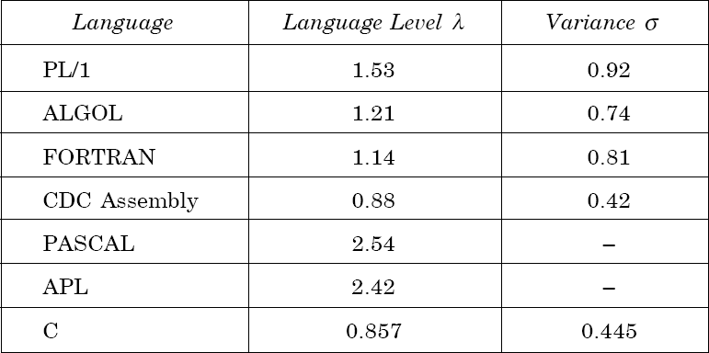
For a particular programming language , if V* increases, L decreases in such a way that V*×L remains constant, this constant is called language level (λ)
Table 1: Language levels

Slide 22
Example- I
Consider the sorting program given. List out the operators and operands and also calculate the values of software science measures like η, N ,V , E, λ etc.

Slide 23
1. | int. sort (int x[ ], int n)
2. | {
3. | int i, j, save, im1;
4. | /*This function sorts array x in ascending order */
5. | If (n<2) return 1;
6. | for (i=2; i<=n; i++)
7. | {
8. | im1=i-1;
9. | for (j=1; j<=im; j++)
10. | if (x[i] < x[j])
11. | {
12. | save = x[i];
13. | x[i] = x[j];
14. | x[j] = save;
15. | }
16. | }
17. | return 0;
18. | }

Slide 24
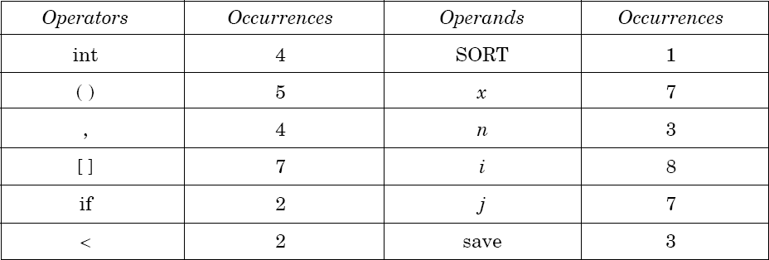
Solution
The list of operators and operands is given in table 2.

Slide 25
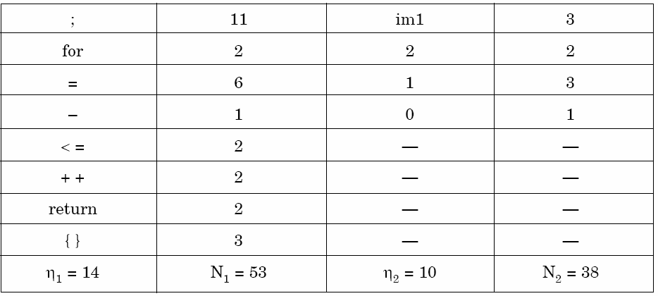
Table 2: Operators and operands of sorting program

Slide 26
Here N₁=53 and N₂=38. The program length N=N₁+N₂=91
Vocabulary of the program η = η₁ +η₂ = 14 +10 = 24
V = N ×log₂ η
= 91 x log₂24 = 417 bits
∧
The estimated program length _{N} of the program
= 14 log₂14 + 10 log₂10
= 14 * 3.81 + 10 * 3.32
Volume
= 53.34 + 33.2 = 86.45

Slide 27
Conceptually unique
input and output parameters are
represented by η*
2
η* = 3
{x: array holding the integer to be sorted. This is used both as input and output}.
{N: the size of the array to be sorted}.
2
The potential volume V* = 5 log₂5 = 11.6
Since L = V* / V

Slide 28
= ^{11.6} = 0.027
417
D = I / L
1
=
= 37.03
0.027
Estimated program level
∧
L = ×
2 η₂ 2 10
= × = 0.038
η₁ N₂
14 38

Slide 29
We may use another formula
∧ ∧
= V / L
= 417/ 0.038
= 10973.68
Therefore, 10974
elementary mental discrimination are
required to construct the program.
T = E / β = ¹⁰⁹⁷⁴ = 610 seconds = 10 minutes
18
This is probably a reasonable time to produce the program, which is very simple

Slide 30
Example- 2
Consider the program shown software science metrics.
in Table 3. Calculate the various

Slide 31
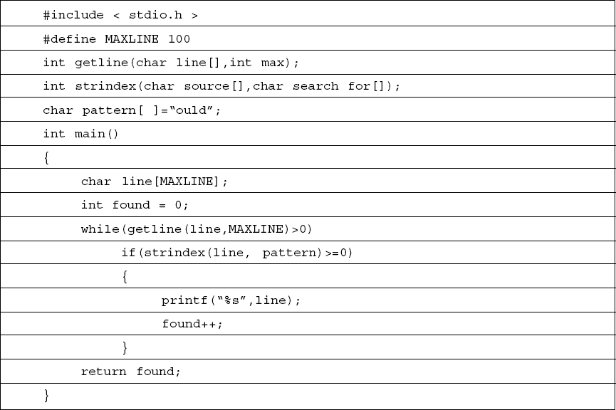

Slide 32
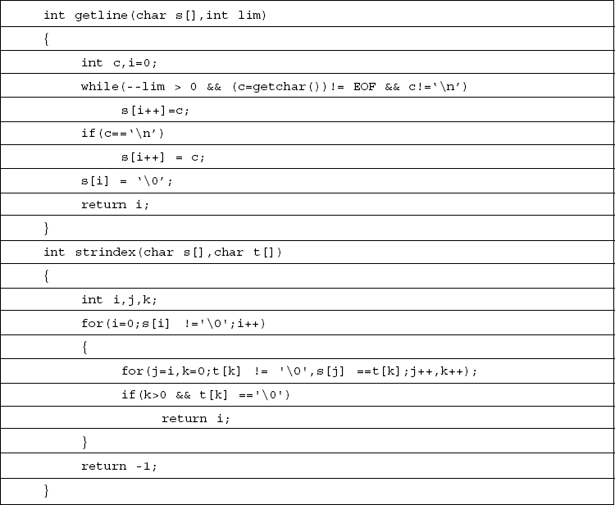

Slide 33
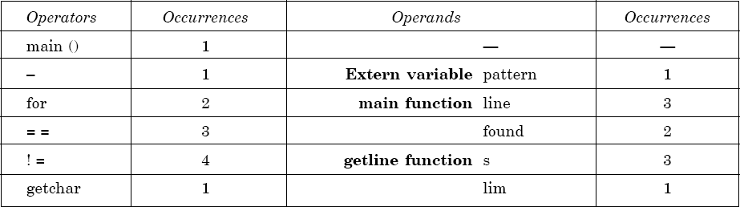
Solution
List of operators and operands are given in Table 4.
Table 4

Slide 34
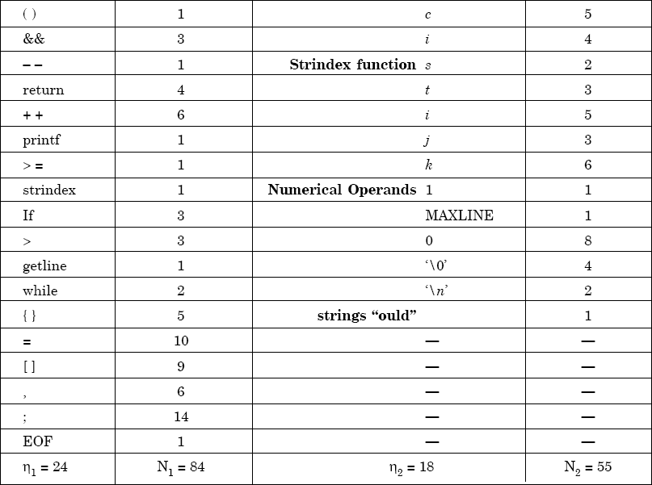

Slide 35
Program vocabulary η = 42
N = N₁ +N₂
= 84 + 55 = 139
∧
N = 24 log₂ 24 +18 log₂ 18 = 185.115
= 24.91
V = 749.605 bits
Program length
Estimated length
% error
Program volume
₌ 2 × η₂
Estimated program level
η₁ N₂
= ² × ¹⁸ = 0.02727
24 55

Slide 36
Minimal volume
V*=20.4417
∧
= V / L
₌ 748.605
Effort
.02727
= 27488.33 elementary mental discriminations.
27488.33
Time T =
E / β =
18
= 1527.1295 seconds
= 25.452 minutes

Slide 37
Maintenance Metrics
There are two categories of maintenance key performance indicators which include the leading and lagging indicators. The leading indicators signal future events and the lagging indicators follow the past events.
Using these maintenance metrics and turning the data into actionable information, organizations can acquire both qualitative and quantitative insights.

Slide 38
Maintenance Metrics
1. Planned maintenance percentage (PPC)
This metrics represents the percentage of time spent on planned maintenance activities against the unplanned
PPC= (scheduled maintenance time/total maintenance hours) x 100
In a great system, 90% of the maintenance should be planned.

Slide 39
Maintenance Metrics
2. Overall Equipment Effectiveness (OEE)
OEE is the measure of the productivity of a piece of equipment. It gives informed data on how effective organization’s maintenance processes is running based on factors like equipment quality, performance, and availability
A 100% OEE means that your system is producing no defects, as fast as possible, and with no stops in the production.
OEE = availability x performance x quality

Slide 40
Maintenance Metrics
Availability
Availability takes into account Availability Loss, which includes any events that stop planned production for an appreciable length of time (usually several minutes; long enough for an operator to log a reason)
The remaining time after Availability Loss is subtracted is called Run Time.
Runtime = Total time – Available time

Slide 41
Maintenance Metrics
PERFORMANCE
Performance takes into account Performance Loss, which accounts for anything that causes the manufacturing process to run at less than the maximum possible speed when it is running (including both Slow Cycles and Small Stops).
The remaining time after Performance Loss is subtracted is called Net Run Time

Slide 42
Maintenance Metrics
QUALITY
Quality takes into account Quality Loss, which accounts for outputs that do not meet quality standards.
The remaining time after Quality Loss is subtracted is called Fully Productive Time.
Our goal is not simply to measure OEE – it is to maximize Fully Productive Time.

Slide 43
Maintenance Metrics
3. Mean time to repair (MTTR)
The MTTR clock starts ticking when the repairs start and it goes on until operations are restored. This includes repair time, testing period, and return to the normal operating condition.
MTTR= (SUM of downtime periods/ total number of repairs)

Slide 44
Maintenance Metrics
4. Mean time between failure (MTBF)
MTBF is the measure of the predicted time between one breakdown to the next during normal operation.
MTBF tells the expected lifetime for the software. Higher MTBF means that the software (or product) will work longer before it experiences failure
MTBF= (SUM of operational time/total number of failures)

Slide 45
Maintenance Metrics
5. Preventive maintenance compliance (PMC)
PM compliance is defined as the percentage of the preventive work scheduled and completed in a set time.
For example, we might have 60 operations (that are a part of the PM plan) scheduled but 51 completed at the end of the month.
In this case:
PMC= (51/60) x 100 = 85%

